Slide 1
ECOMMERCE APPLICATION
USING
SPRING MICROSERVICES
TECHNOLOGIES : JAVA, SPRING BOOT, SPRING CLOUD, SPRING DATA JPA, MYSQL, POSTMAN
PRESENTER NAME: ZEBA QUMAR

Slide 2
OBJECTIVE
This project is to develop a scalable and maintainable distributed E-commerce application using a microservices architecture with spring boot. The application is designed main user role:
User: can browse product, place order , manage their accounts, ensuring a smooth and user-friendly shopping experience.

Slide 3
SERVICE REGISTRY(EUREKA SERVER)
API-Gateway
E-commerce
Customer-service
Microservices
Product-service
Order-service
Cart-service
SPRING CLOUD Gateway
Application
Auth-service
DATABASE 1
DATABASE 2
DATABASE 3
CLIENT
DATABASE 4
DATABASE 5

Slide 4
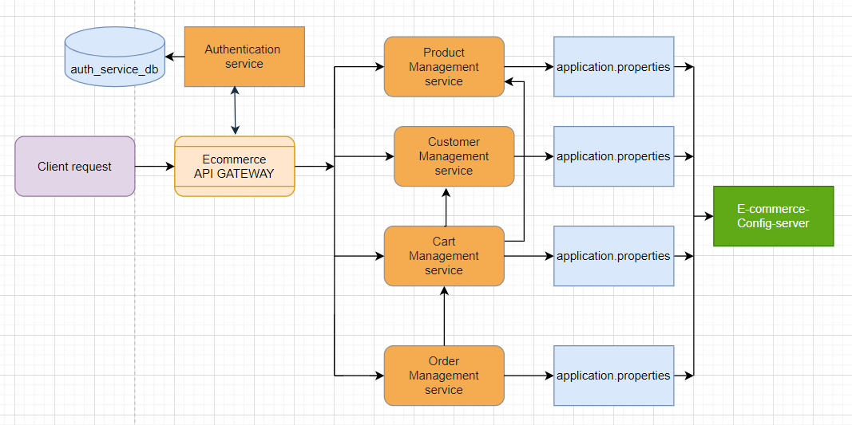
FLOW DIAGRAM

Slide 5
Microservices
PRODUCT-SERVICES
CUSTOMER-SERVICE
CART-SERVICE
ORDER-SERVICE
AUTH-SERVICE

Slide 6
SERVICE REGISTRY & DISCOVERY EUREKA SERVER
In an e-commerce application, you might have various microservices handling different functionalities, such as user management, product catalog, order processing, and payment. Eureka helps manage these services by:
Allowing services to register themselves at runtime.
Providing a registry where services can look up other services they need to interact with.
Supporting service discovery for load balancing and fault tolerance.

Slide 7
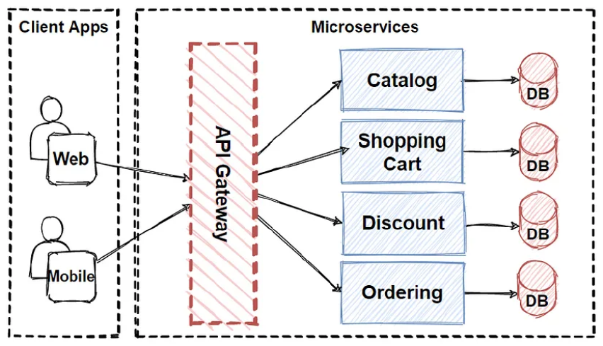
API GATEWAY
Spring cloud Gateway:
Acts as the entry point all client requests.
Handles routing security, rate limiting and logging.

Slide 8
CONFIG-SERVER
A "config server" in the context of GitHub usually refers to a server or system used to manage and serve configuration files for applications, often in a microservices architecture.
Integration with GitHub: This might involve using GitHub to store configuration files. For example, configuration files might be stored in a GitHub repository, and a config server might be used to fetch and serve these files to applications. This can be done using various tools or custom implementations.

Slide 9

AUTHENTICATION SERVICE
Functions:
User Registration and Login
JWT Token Generation
Role Management(User)

Slide 10

CUSTOMER MANAGEMENT MICROSERVICE
Customer Profiles:
Manages customer information, including shipping addresses and order history.
Provides APIs for customers to update their profiles and view their past orders.

Slide 11
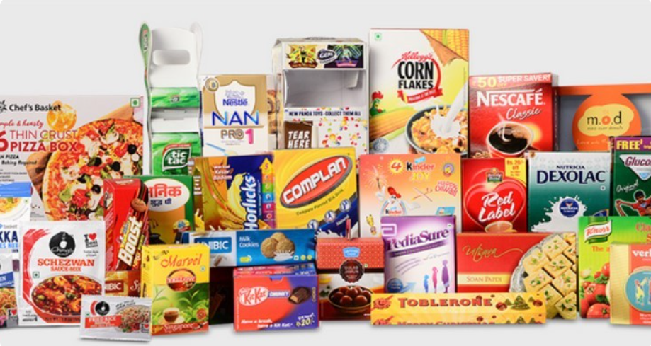
PRODUCT MANAGEMENT MICROSERVICE
Product Catalog:
Responsible for managing product listings.
Provides APIs for adding, editing, deleting, and fetching product details.
Handles categories, product descriptions, pricing, stock and availability.

Slide 12
CART MANAGEMENT MICROSERVICE
CART CATALOG:
Responsible to manage all the cart product.
Provides APIs for CRUD operations.
Handling cart product and item entry in the database.

Slide 13
ORDER MANAGEMENT MICROSERVICE
Order Processing:
Manages the lifecycle of customer orders from creation to fulfillment.
Provides APIs for creating, viewing, updating, and canceling orders.
Handles payment processing and order status updates.

Slide 14
THANK YOU

